Slide 1

Dictionary

Slide 2
Data Types
Data Type | Examples
integer | 22, 5, 94, -30, -24
float | 0.5, 1.25, 3.14, -4.5, -2.7
string | “hello”, “4 cats”, “a”, “aa”, “7”
boolean | True, False
list | [“Rejep”, “Meret”, “Oraz”, “Gurban”]
dictionary | {“book” : “kitap”, “read” : “okamak”}

Slide 3
What is the Dictionary?
Dictionary are used to store multiple items in a single variable.
Dictionary are one of 4 built-in data types in Python used to store collections of data, the other 3 are Tuple, Set, and List, all with different qualities and usage.

Slide 4
Dictionary
Dictionaries are used to store data values in key:value pairs.
A dictionary is a collection which is ordered, changeable and do not allow duplicates.

Slide 5
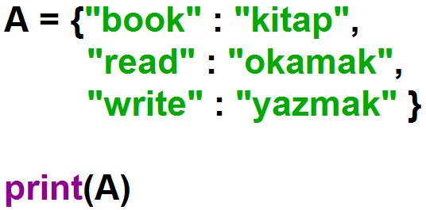
Create a Dictionary
Dictionaries are written with curly brackets, and have keys and values:

Slide 6
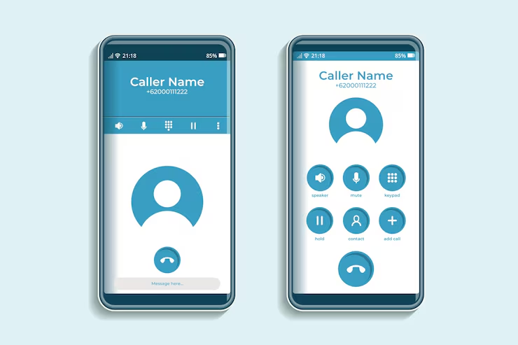
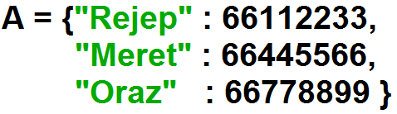
Phone Contacts App
Example

Slide 7
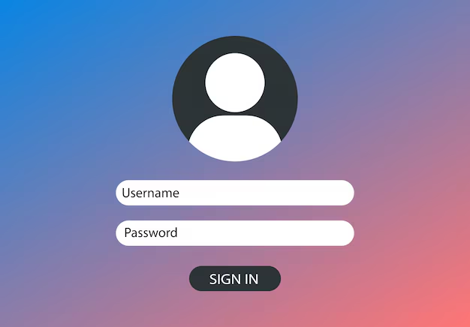
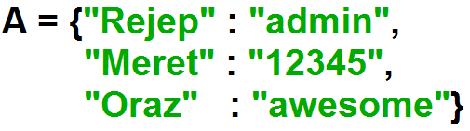
Sign In App
Example

Slide 8
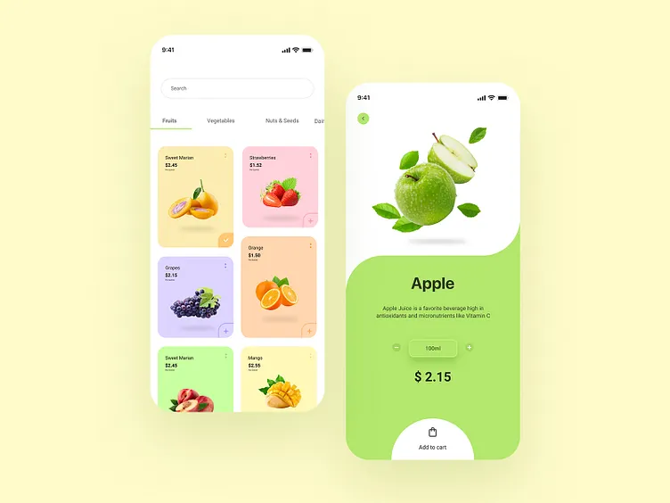
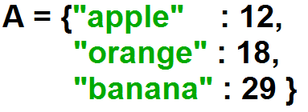
Fruits Store App
Example

Slide 9
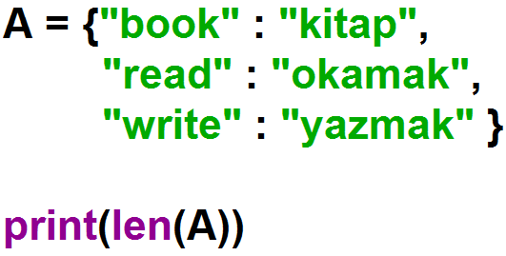

Dictionary Length
To get the length of a dictionary, use the len() function.

Slide 10
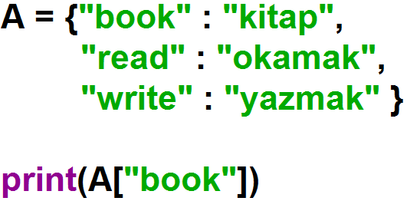

Accessing Items
Access the items of a dictionary by referring to its key name, inside square brackets:

Slide 11
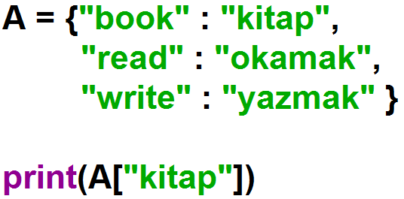

Accessing Items
Access the items of a dictionary by referring to its key name, inside square brackets:

Slide 12
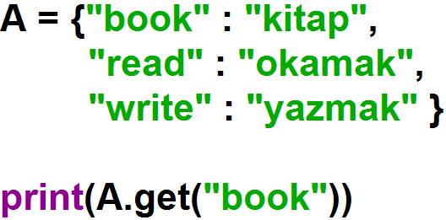
Accessing Items
There is also a method called get() that will give you the same result:

Slide 13
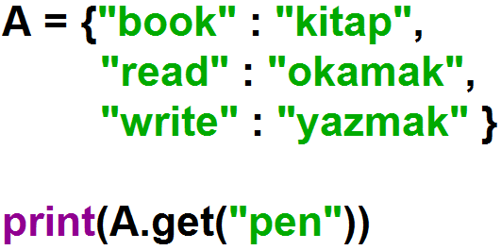

Accessing Items
There is also a method called get() that will give you the same result:

Slide 14
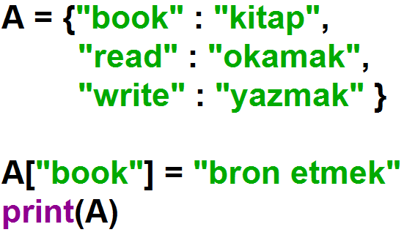
Change Dictionary Items
Сhange the value of a specific item by referring to its key name:

Slide 15
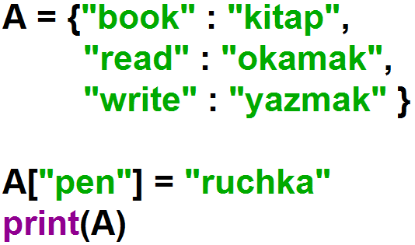
Add Dictionary Items
Adding an item to the dictionary is done by using a new index key and assigning a value to it.

Slide 16
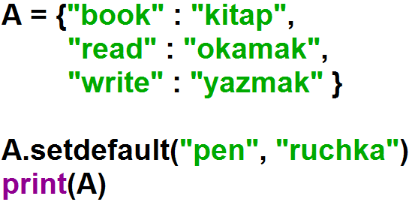
Add Dictionary Items
The setdefault() method returns the value of the item with the specified key.

Slide 17
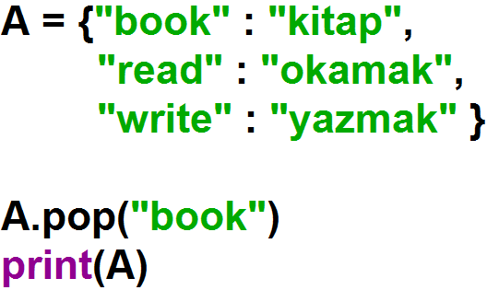
Remove Dictionary Items
The pop() method removes the item with the specified key name.

Slide 18
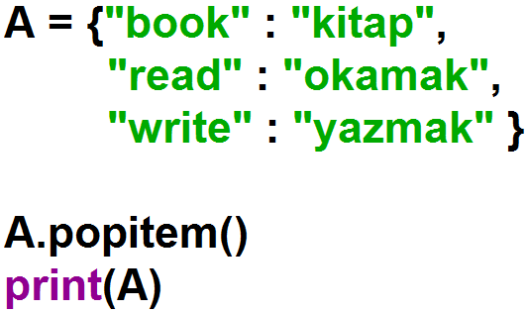
Remove Dictionary Items
The popitem() method removes the last inserted item.

Slide 19
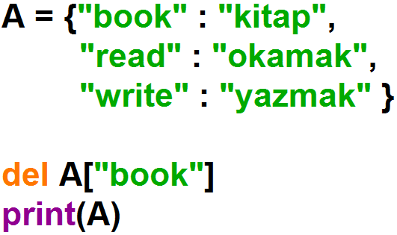
Remove Dictionary Items
The del keyword removes the item with the specified key name.

Slide 20
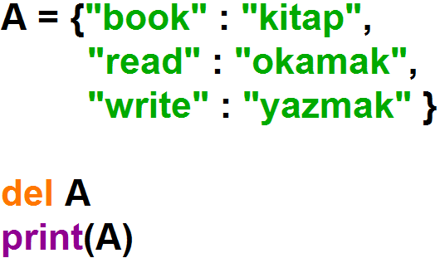
Remove Dictionary Items
The del keyword can also delete the dictionary completely.

Slide 21
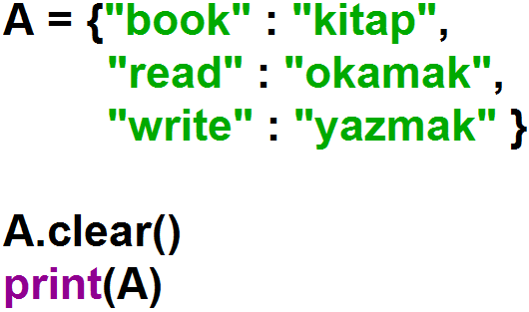

Remove Dictionary Items
The clear() method empties the dictionary.

Slide 22
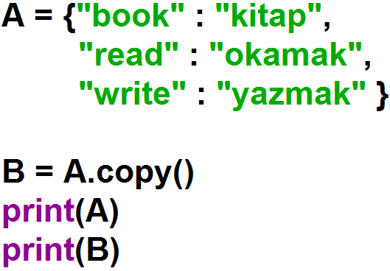
Copy Dictionaries
Make a copy of a dictionary with the copy() method.

Slide 23
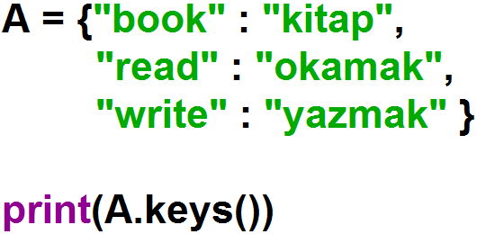
Access Dictionary Keys
The keys() method to return keys of a dictionary.

Slide 24
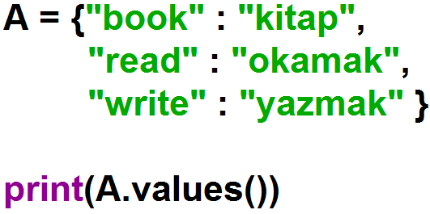
Access Dictionary Values
The values() method to return values of a dictionary.

Slide 25
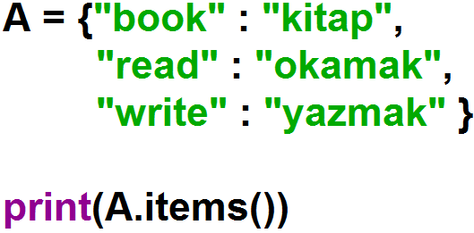
Access Dictionary Items
The items() method to return both keys and values of a dictionary.

Slide 26
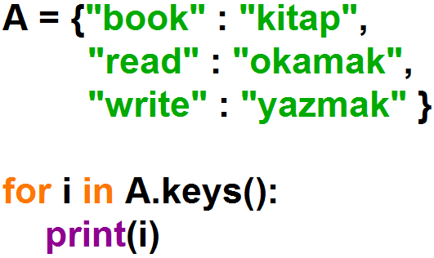
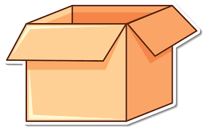
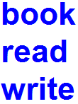
Loop Dictionaries
Print all keys in the dictionary, one by one.
A
i

Slide 27
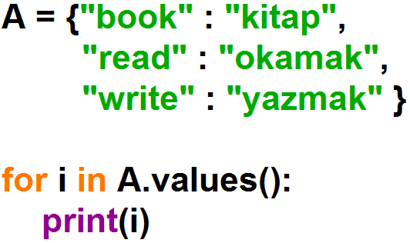
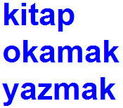
Loop Dictionaries
Print all values in the dictionary, one by one.
A
i

Slide 28
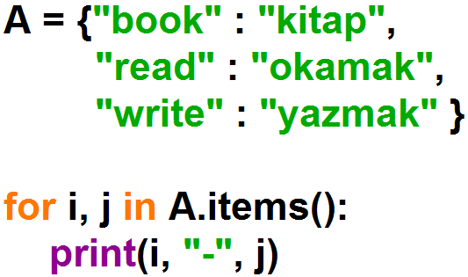
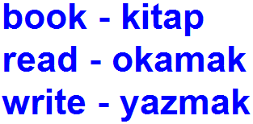
Loop Dictionaries
Print all items in the dictionary, one by one.
A
i
j

Slide 29
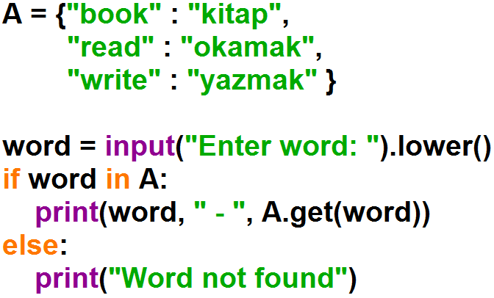
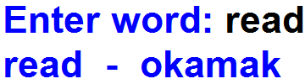

Example: Get a word from the user. If the word is in the dictionary, print its translation, else print the message "word not found".

Slide 30
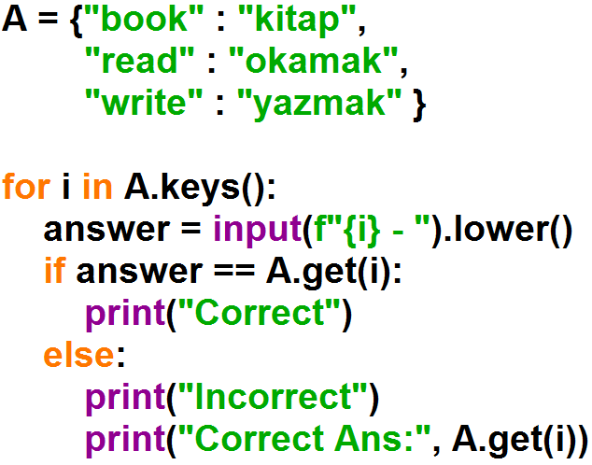
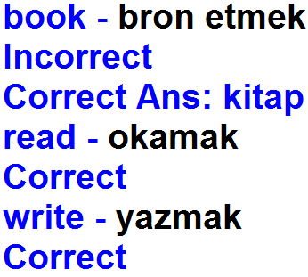
Example: Get the translation of the given word from the user. If the user answer is correct, print the message "Correct", else print the message "Incorrect".

